Slide 1
Transactional systems
COURSE 8: Databases

Slide 2
Transactional systems

Slide 3
Transaction
Set of operations on the database, set of statements:
insert, update, delete
Delimited by statements or function calls of type:
begin transaction
end transaction
All operations are finalized with success, or none is saved in the db.
A transactional system must
manage concurrent transactions.
ensure consistent data in case of failure.

Slide 4
Transaction
Statement 1
Statement 2
commit -- end transaction 1
Statement 3
Statement 4
Statement 5
commit -- end transaction 2

Slide 5
Transaction properties
ACID

Slide 6
ATOMICITY
CONSISTENCY
ISOLATION
DURABILITY
all changes or none
collection of steps → single indivisible unit.
If one operation fails all changes to the database must be undone
Failures in transaction, example: statement error, violating unique constraint.
System failures, OS crashed.

Slide 7
ATOMICITY
CONSISTENCY
ISOLATION
DURABILITY
If a transaction is run starting from a database in a consistent state, the database must be consistent at the end of the transaction.
Database constraints
PRIMARY KEY key constraint, UNIQUE, NOT NULL, FOREIGN KEY referential integrity, CHECK
Business constrains

Slide 8
ATOMICITY
CONSISTENCY
ISOLATION
DURABILITY
The database may at some point be in an inconsistent state.
Inconsistencies are not visible in a database system (ensured by atomicity).
The old values of any data on which a transaction performs is written to a log file used by a
→ recovery system

Slide 9
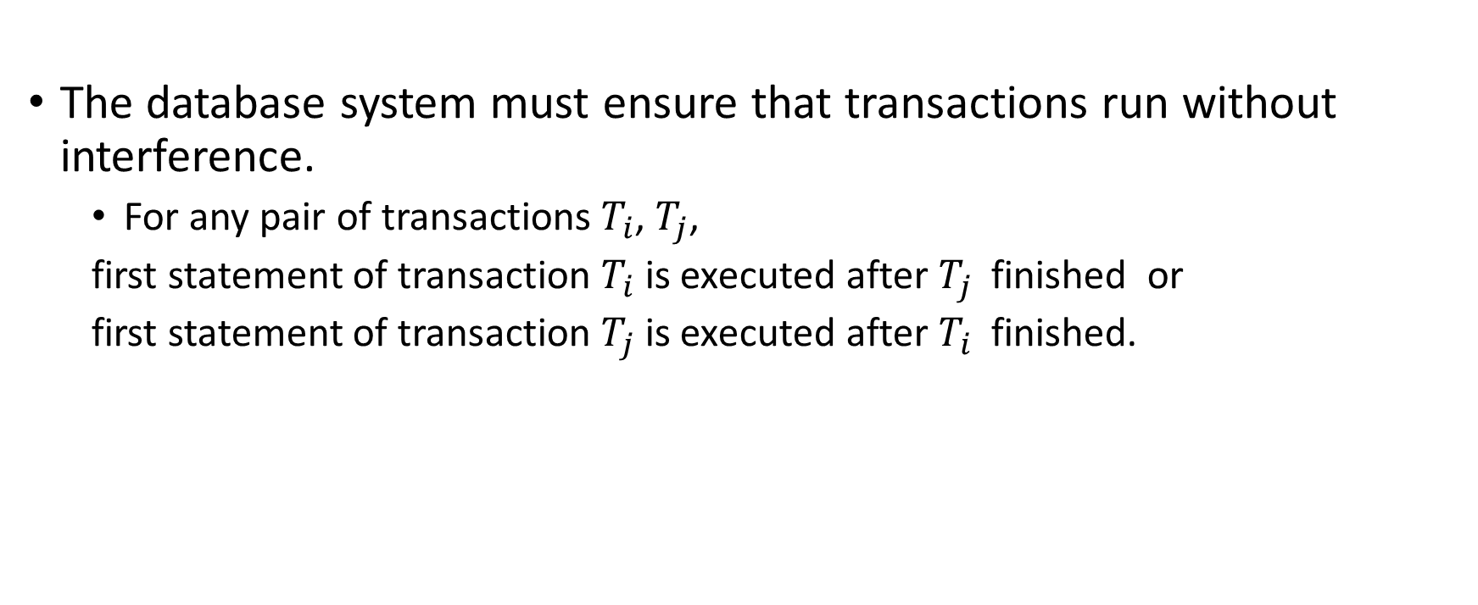
ATOMICITY
CONSISTENCY
ISOLATION
DURABILITY
The database system must ensure that transactions run without interference.
For any pair of transactions $T_{i}$, $T_{j}$,
first statement of transaction $T_{i} \text{is}$ executed after $T_{j}$ finished or
first statement of transaction $T_{j} \text{is}$ executed after $T_{i}$ finished.

Slide 10
ATOMICITY
CONSISTENCY
ISOLATION
DURABILITY
After a transaction completes successfully, the changes it has made to the database persist, even if there are system failures.
Information about the updates performed by the transaction is written to disk and used to reconstruct the database after failure.
→ recovery system

Slide 11
Transaction states

Slide 12
partially committed
committed
Initial state
LOG file
write old and new value
active
failed
aborted

Slide 13
partially committed
committed
Initial state
LOG file
write old and new value
active
terminated
RECOVERY SYSTEM
INITIAL CONSISTENT STATE FAILURE
FINAL CONSISTENT STATE
failed
aborted

Slide 14
partially committed
committed
Final statement executed
active
failed
aborted

Slide 15
partially committed
committed
Final statement executed
Log → hardware failure →
System restart
recover updates ← Log
DURABILITY
active
failed
aborted

Slide 16
partially committed
committed
Successful completion
active
failed
aborted

Slide 17
partially committed
committed
active
Normal execution cannot proceed
failed
aborted

Slide 18
partially committed
committed
active
Normal execution cannot proceed
failure → recover initial state ← LOG
CONSISTENCY
failed
aborted

Slide 19
partially committed
committed
active
Rollbacked, initial stat resolved
failed
aborted

Slide 20
Concurrent transactions

Slide 21
Concurrent transactions
Reduce response time: time for a transaction to be completed.
Improved workload/resource utilization.
ISOLATION may be violated → as a result database may be found in an inconsistent state
→ Concurrency control

Slide 22
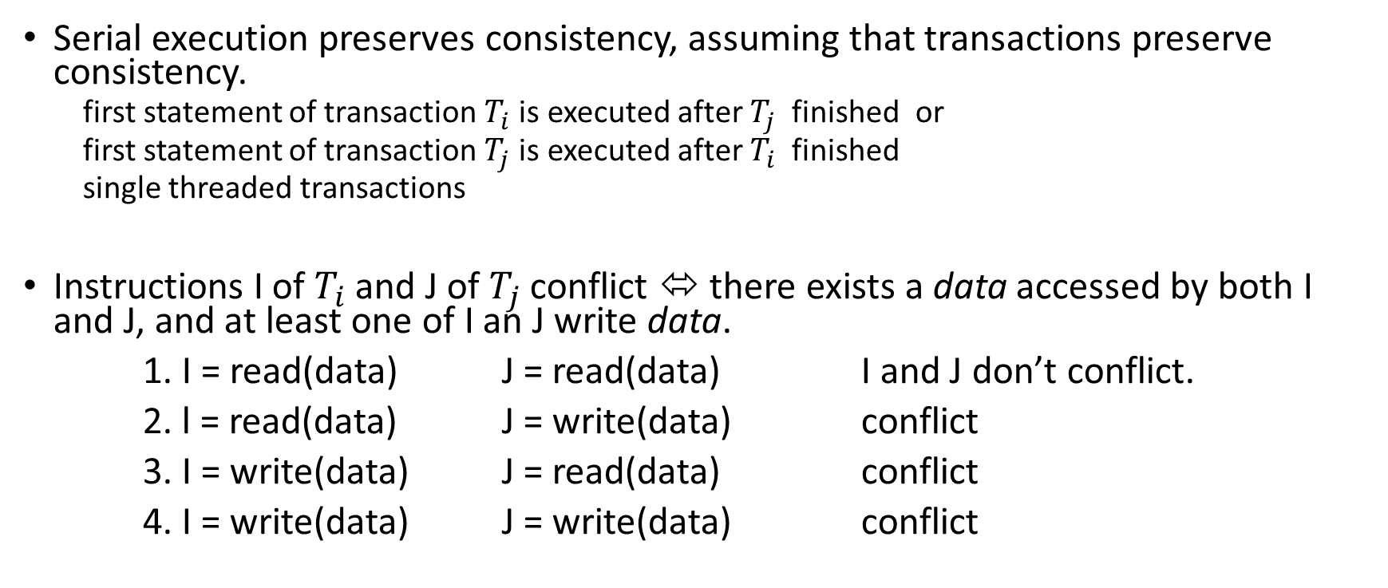
Concurrent transactions - conflicts
Serial execution preserves consistency, assuming that transactions preserve consistency.
first statement of transaction $T_{i} \text{is}$ executed after $T_{j}$ finished or
first statement of transaction $T_{j} \text{is}$ executed after $T_{i}$ finished
single threaded transactions
Instructions I of $T_{i}$ and J of $T_{j}$ conflict ⬄ there exists a data accessed by both I and J, and at least one of I an J write data.
1. I = read(data) J = read(data) I and J don’t conflict.
2. l = read(data) J = write(data) conflict
3. I = write(data) J = read(data) conflict
4. I = write(data) J = write(data) conflict

Slide 23
Concurrent transactions -- Schedules
Schedules: sequences of instructions that specify the chronological order in which instructions of concurrent transactions are executed
A schedule for a set of transactions must consist of all instructions of those transactions.
A schedule must preserve the order in which the instructions appear in each individual transaction.
A transaction that successfully completes its execution will have a commit instructions as the last statement
By default transaction assumed to execute commit instruction as its last step.
A transaction that fails to successfully complete its execution will have an abort instruction as the last statement.

Slide 24
Schedules example S1
T1 | T2
read (A) A := A - 50 write (A) read (B) B := B + 50 write (B) commit
 | read (A) temp := A * 0.1 A := A - temp write (A) read (B) B := B + temp write (B) commit
Serial execution.
No conflicts.
DB in consistent state
A.new + B.new = A.old + B.old

Slide 25
Schedules example S2
T1 | T2
read (A) A := A - 50 write (A)
 | read (A) temp := A * 0.1 A := A - temp write (A)
read (B) B := B + 50 write (B) commit
 | read (B) B := B + temp write (B) commit
Not a serial execution.
Equivalent to Schedule S1.
DB in consistent state
A.new + B.new = A.old + B.old

Slide 26
Concurrent transactions
A (possibly concurrent) schedule is serializable if it is equivalent to a serial schedule. Different forms of schedule equivalence:
1. Conflict serializability
2. View serializability

Slide 27
Concurrent transactions
A (possibly concurrent) schedule is serializable if it is equivalent to a serial schedule. Different forms of schedule equivalence:
1. Conflict serializability
If a schedule S can be transformed into a schedule S’ by a series of swaps of non-conflicting instructions, we say that S and S’ are conflict equivalent.
2. View serializability

Slide 28
Schedules example S2
T1 | T2
read (A) A := A - 50 write (A)
 | read (A) temp := A * 0.1 A := A - temp write (A)
read (B) B := B + 50 write (B) commit
 | read (B) B := B + temp write (B) commit
Not a serial execution.
Equivalent to Schedule S1.
DB in consistent state
A.new + B.new = A.old + B.old
no conflict, no data item is updated by both blocks, by swapping the two blocks we obtain S1

Slide 29
Schedules example S3
T1 | T2
read (A) A := A - 50
 | read (A) temp := A * 0.1 A := A - temp write (A)
write (A) read (B) B := B + 50 write (B) commit
 | read (B) B := B + temp write (B) commit
Not a serial execution.
Not equivalent to Schedule S1.
DB in inconsistent state
A.new + B.new != A.old + B.old
conflict, A is updated by both blocks

Slide 30
Concurrent transactions
1. Conflict serializability
2. View serializability
Let S and S’ be 2 schedules with the same set of transactions. S and S’ are view equivalent if the following 3 conditions are met, for each data item Q:
If in schedule S, transaction Ti reads the initial value of Q, then in schedule S’ also transaction Ti must read the initial value of Q.
If in schedule S transaction Ti executes read(Q), and that value was produced by transaction Tj (if any), then in schedule S’ also transaction Ti must read the value of Q that was produced by the same write(Q) operation of transaction Tj .
The transaction (if any) that performs the final write(Q) operation in schedule S must also perform the final write(Q) operation in schedule S’.
View equivalence is based purely on reads and writes alone.

Slide 31
Concurrent transactions
Test serializability :
2. View serializability
The problem of checking if a schedule is view serializable falls in the class of NP-complete problems. Thus, existence of an efficient algorithm is extremely unlikely.
Practical algorithms that just check some sufficient conditions for view serializability can still be used.

Slide 32
Concurrent transactions
Test serializability:
1. Conflict serializability
Consider some schedule of a set of transactions T1, T2, ..., Tn
Precedence graph — a direct graph where the vertices are the transactions (names).
We draw an arc from Ti to Tj if the second transaction conflict, and Ti accessed the data item on which the conflict arose earlier.
We may label the arc by the item that was accessed.
A schedule is CS if and only if its precedence graph is acyclic.
If precedence graph is acyclic, the serializability order can be obtained by a topological sorting of the graph.

Slide 33
Conflict serializability
T1: read (A) A := A - 50
 | T2: read (A) temp := A * 0.1 A := A - temp write (A)
T1: write (A) read (B) B := B + 50 write (B) commit
 | T3: read (B) B := B + temp write (B) commit
T1
B
T2
A
…
T3
conflict, A is updated by both blocks

Slide 34
Isolation levels

Slide 35
Isolation levels
Isolation: execute a transaction as if there are no other concurrent transactions running simultaneously.
Prevent read or write of incorrect, temporary, aborted data processed by concurrent transactions
Isolation levels: trade off between perfect isolation and performance
response time: time before a transaction completes
throughput: number of transactions per second

Slide 36
Level Serializability, perfect isolation
The final state of the database is equivalent to a state of the database if the transactions were run sequentially.
serializable schedule
Way of obtaining serializability:
locking
timestamp validation
multi-versioning

Slide 37
Transactions errors
T1 | T2
select qte into :nS from stock where n_prod = 100 --nS = 13
 | select qte into :nS from stock where n_prod = 100
update stock set qte = :nS - 1 where n_prod = 100
 | update stock set qte = :nS - 1 where n_prod = 100
insert into orders(n_prod, qte) values(100, 1) commit
 | insert into orders(n_prod, qte) values(100, 1)
lost-update anomaly
final stock 12!

Slide 38
Transactions errors
T1 | T2
select qte into :nS from stock where n_prod = 100 --nS = 13
update stock set qte = :nS - 1 where n_prod = 100
 | select sum(qte) into :nO from orders where n_prod = 100 select qte into :nS from stock where n_prod = 100 --nO+nS!=init_stock
insert into orders(n_prod, qte) values(100, 1) commit
dirty-read anomaly
number of products ordered + qte_stock != initial stock
1 product missing!
Read uncommitted data

Slide 39
Transactions errors
T1 | T2
… | select qte into :nS from stock where n_prod = 100 --nS = 10
 | if nS < 15 and nS >= 10 insert into restock(n_prod, qte) values(100, 5)
update stock set qte = :nS - 1 where n_prod = 100 insert into orders (n_prod, qte) values(100, 1) commit
 | select qte into :nS from stock where n_prod = 100 if nS < 10 insert into restock(n_prod, qte) values(100, 15)
non-repeatable read anomaly
only one insert into restock is needed!
read twice, different values

Slide 40
Transactions errors
T1 | T2
 | select MAX(qte) into :max from orders where n_prod = 100
insert into orders(n_prod,qte) values(100, 789455) commit
 | select AVG(qte) into :avarage from orders where n_prod = 100
phantom-read anomaly
AVG > MAX!
new lignes inserted

Slide 41
Transactions errors
T1 | T2
select qte into :nS from stock where n_prod = 100 --nS = 13
update stock set qte = qte - 1 where n_prod = 100
 | select qte into :nS from stock where n_prod = 100 --nS = 12
 | update stock set qte = qte - 1 where n_prod = 100 --nS = 11
abort
 | insert … commit
dirty-write anomaly
final stock 11! In the first transaction, the stock returns to 13. Only one update should decrease the number of products.

Slide 42


Isolation levels
weaker the isolation level → more anomalies may occur
 | ERROR | dirty-reads | non-repeatable reads | phantom
LEVEL
READ UNCOMMITTED
READ COMMITTED
REPEATABLE READ
SERIALIZABLE

Slide 43
Isolation levels
allows uncommitted data to be read
all isolation levels prevent writes to a data item that has already been written by another transaction not yet committed or aborted (rollbacked).
 | ERROR | lost-update | dirty-reads | non-repeatable reads | phantom
LEVEL
READ UNCOMMITTED

Slide 44
READ UNCOMMITTED
T1 | T2
select qte into :nS from stock where n_prod = 100 --nS = 13
update stock set qte = :nS - 1 where n_prod = 100
 | select sum(qte) into :nO from orders where n_prod = 100 select qte into :nS from stock where n_prod = 100 --nO+nS!=init_stock
insert into orders(n_prod, qte) values(100, 1) commit
dirty-read anomaly
number of products ordered + qte_stock != initial stock
1 product missing!

Slide 45
READ UNCOMMITTED
T1 | T2
… | select qte into :nS from stock where n_prod = 100 --nS = 10
 | if nS < 15 and nS >= 10 insert into restock(n_prod, qte) values(100, 5)
update stock set qte = :nS - 1 where n_prod = 100 insert into orders (n_prod, qte) values(100, 1)
 | select qte into :nS from stock where n_prod = 100 if nS < 10 insert into restock(n_prod, qte) values(100, 15)
non-repeatable read anomaly
only one insert into restock is needed!

Slide 46
READ UNCOMMITTED
T1 | T2
 | select MAX(qte) into :max from orders where n_prod = 100
insert into orders(n_prod,qte) values(100, 789455) commit
 | select AVG(qte) into :avarage from orders where n_prod = 100
phantom-read anomaly
AVG > MAX!

Slide 47
Isolation levels
read only committed
does not require repeatable reads. Between two reads of a data item by the transaction, another transaction may have updated the data item and committed.
 | ERROR | lost-update | dirty-reads | non-repeatable reads | phantom
LEVEL
READ COMMITTED

Slide 48
READ COMMITTED
T1 | T2
select qte into :nS from stock where n_prod = 100 --nS = 13
update stock set qte = :nS - 1 where n_prod = 100
 | select sum(qte) into :nO from orders where n_prod = 100 select qte into :nS from stock where n_prod = 100 --nO+nS!=init_stock
insert into orders(n_prod, qte) values(100, 1) commit
dirty-read anomaly
number of products ordered + qte_stock != initial stock
1 product missing!

Slide 49
READ COMMITTED
T1 | T2
select qte into :nS from stock where n_prod = 100 --nS = 13
 | select qte into :nS from stock where n_prod = 100
update stock set qte = :nS - 1 where n_prod = 100
 | update stock set qte = :nS - 1 where n_prod = 100
insert into orders(n_prod, qte) values(100, 1) commit
 | insert into orders(n_prod, qte) values(100, 1)
lost-update anomaly
final stock 12!

Slide 50
Isolation levels
read only committed
between two reads of an item by a transaction, no other transaction is allowed to update it.
a transaction may find other data inserted by a committed transaction
 | ERROR | lost-update | dirty-reads | non-repeatable reads | phantom
LEVEL
REPEATABLE READ

Slide 51
Isolation levels
allows uncommitted data to be read
all the isolation levels prevent writes to a data item that has already been written by another transaction not yet committed or aborted (rollbacked).
 | ERROR | lost-update | dirty-reads | non-repeatable reads | phantom
LEVEL
READ UNCOMMITTED

Slide 52
Isolation levels
read only committed
between two reads of a data item by the transaction, another transaction may have updated the data item and committed.
 | ERROR | lost-update | dirty-reads | non-repeatable reads | phantom
LEVEL
READ COMMITTED

Slide 53
READ COMMITTED
T1 | T2
… | select qte into :nS from stock where n_prod = 100 --nS = 10
 | if nS < 15 and nS >= 10 insert into restock(n_prod, qte) values(100, 5)
update stock set qte = :nS - 1 where n_prod = 100 insert into orders (n_prod, qte) values(100, 1)
 | select qte into :nS from stock where n_prod = 100 if nS < 10 insert into restock(n_prod, qte) values(100, 15)
non-repeatable read anomaly
only one insert into restock is needed!

Slide 54
READ COMMITTED
T1 | T2
 | select MAX(qte) into :max from orders where n_prod = 100
insert into orders(n_prod,qte) values(100, 789455) commit
 | select AVG(qte) into :avarage from orders where n_prod = 100
phantom-read anomaly
AVG > MAX!

Slide 55
Isolation levels
read only committed, default in MySQL
between two reads of an item by a transaction, no other transaction is allowed to update it.
a transaction may find other data inserted by a committed transaction
 | ERROR | lost-update | dirty-reads | non-repeatable reads | phantom
LEVEL
REPEATABLE READ

Slide 56
REPEATABLE READ
T1 | T2
select qte into :nS from stock where n_prod = 100 --nS = 13
 | select qte into :nS from stock where n_prod = 100
update stock set qte = :nS - 1 where n_prod = 100
 | update stock set qte = :nS - 1 where n_prod = 100
insert into orders(n_prod, qte) values(100, 1) commit
 | insert into orders(n_prod, qte) values(100, 1)
lost-update anomaly
final stock 12!

Slide 57
REPEATABLE READ
T1 | T2
select qte into :nS from stock where n_prod = 100 --nS = 13
update stock set qte = :nS - 1 where n_prod = 100
 | select sum(qte) into :nO from orders where n_prod = 100 select qte into :nS from stock where n_prod = 100 --nO+nS!=init_stock
insert into orders(n_prod, qte) values(100, 1) commit
dirty-read anomaly
number of products ordered + qte_stock != initial stock
1 product missing!

Slide 58
REPEATABLE READ
T1 | T2
… | select qte into :nS from stock where n_prod = 100 --nS = 10
 | if nS < 15 and nS >= 10 insert into restock(n_prod, qte) values(100, 5)
update stock set qte = :nS - 1 where n_prod = 100 insert into orders (n_prod, qte) values(100, 1)
 | select qte into :nS from stock where n_prod = 100 if nS < 10 insert into restock(n_prod, qte) values(100, 15)
non-repeatable read anomaly
only one insert into restock is needed!

Slide 59
REPEATABLE READ
T1 | T2
 | select MAX(qte) into :max from orders where n_prod = 100
insert into orders(n_prod,qte) values(100, 789455) commit
 | select AVG(qte) into :avarage from orders where n_prod = 100
phantom-read anomaly
AVG > MAX!

Slide 60
Achieving isolation
Versioning
Transactions read from a “snapshot” of the database.
Locking
Timestamp

Slide 61
Locking
Locks prevent destructive interactions between transactions accessing the same resource.
Shared access to read
Exclusive access to read and write
Locks (Shared, Shared) compatible.
Locks (Shared, Exclusive) not compatible.
A transaction waits until all incompatible locks held by other transactions are released.
https://oracle-base.com/articles/misc/deadlocks
https://docs.oracle.com/cd/B19306_01/server.102/b14220/consist.htm

Slide 62
Snapshot isolation
Snapshot of the database at the beginning of each transaction.
The transaction operates only on that snapshot.
The snapshot consists only of committed values.
Updates are kept in transaction workspace until commit.
Implemented with timestamp-versioning

Slide 63
Consistency levels
To be added, more info in the following video.

Slide 64
BASE
NoSql consistency model

